Slide 1

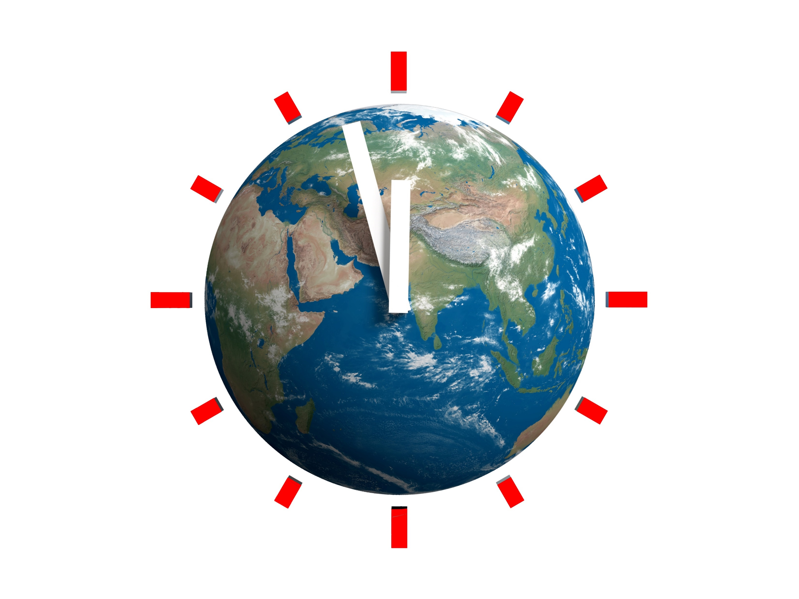
Climate Change
Only 90 seconds to the Doomsday Clock!
We still have time to avoid the worst, but politics is incapable of taking drastic, effective, and timely measures. We must unite and fight together to change the system.
If we do not act now, both the costs and the sacrifices will be enormously greater! It's up to us to choose which future to reserve for ourselves and for future generations.
www.no-extinction.org

Slide 2
Time is About to Expire
Scientists tell us that we have until 2030 at the latest to contain climate change.
Currently, the global average temperature has increased by 1.2 degrees compared to pre-industrial levels and is already causing many problems.
It is predicted that, if we do not intervene drastically and immediately, it could exceed 1.5 degrees by 2025, ahead of previous forecasts, rendering the Paris agreements of 2015 moot.
Beyond this limit, certain natural feedback loops will become unstoppable, which we will examine in detail later on, which will increase CO2 in the atmosphere even if we completely eliminated all emissions. We will no longer be able to do anything.
Therefore, we cannot afford to hesitate because it takes time both to implement measures and due to the inertia of natural systems, the effects of which will be seen after years.

Slide 3
Time is About to Expire
In 2017, more than 15,000 scientists, including many Nobel laureates, as part of the Union of Concerned Scientists (UCS), signed the second warning to humanity stating that a drastic change in the management of Earth's resources is needed to avoid the collapse of the Earth system, including human beings.
Never before have so many experts come together in a heartfelt appeal to policymakers: pay attention, we are taking an irreversible path toward the self-destruction of humanity caused by climate change.
After the global strike on March 15, 2019, the topic of climate change was present in all media. A week later, it was business as usual: the discussion returned to only talking about growth as if the planet could withstand infinite expansion.

Slide 4
Time is About to Expire
Meanwhile, policymakers are doing little or nothing.
Since the necessary measures are unpopular and may result in a loss of votes, they excel in the art of postponement, acting as if they live on another planet, indifferent to the children or grandchildren they love and care for.
Politics is incapable of implementing far-sighted, drastic, effective, and timely measures.
We cannot entrust the task of solving current problems to the policy that has led us to this point.

Slide 5
Time is About to Expire
We will only be able to influence politicians if the masses become aware and young people continue to protest, as they have already begun, with even greater vigor and broader scope, escalating to all-out strikes if necessary.
The future of young people is in grave danger. Politicians are robbing them of it through their indifference, while we, the citizens, preoccupied with daily issues, fail to see or refuse to acknowledge the precipice towards which we are headed. If we truly wish to demonstrate our love for our children and grandchildren, we must act swiftly and do everything in our power to ensure we do not bequeath them a world that is uninhabitable.
"The future will judge us especially for what we could have done but did not do." — (Ermanno Olmi)

Slide 6
Index of the Topics We Will Cover:
What is global warming
The current situation
The appeals of scientists and the pope
What governments are doing
Why It's Going Faster Than Expected
The consequences of climate change
What must be done to reduce the effects
What citizens can do

Slide 7
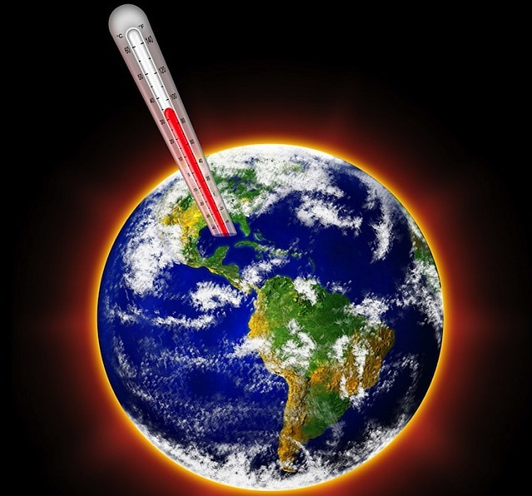
What is Global Warming?
Global warming is a climatological phenomenon involving the increase in the planet's average surface temperature, caused by the greenhouse effect and largely attributed to human activity. The consequences of this phenomenon include climate changes that lead to extreme atmospheric events.

Slide 8
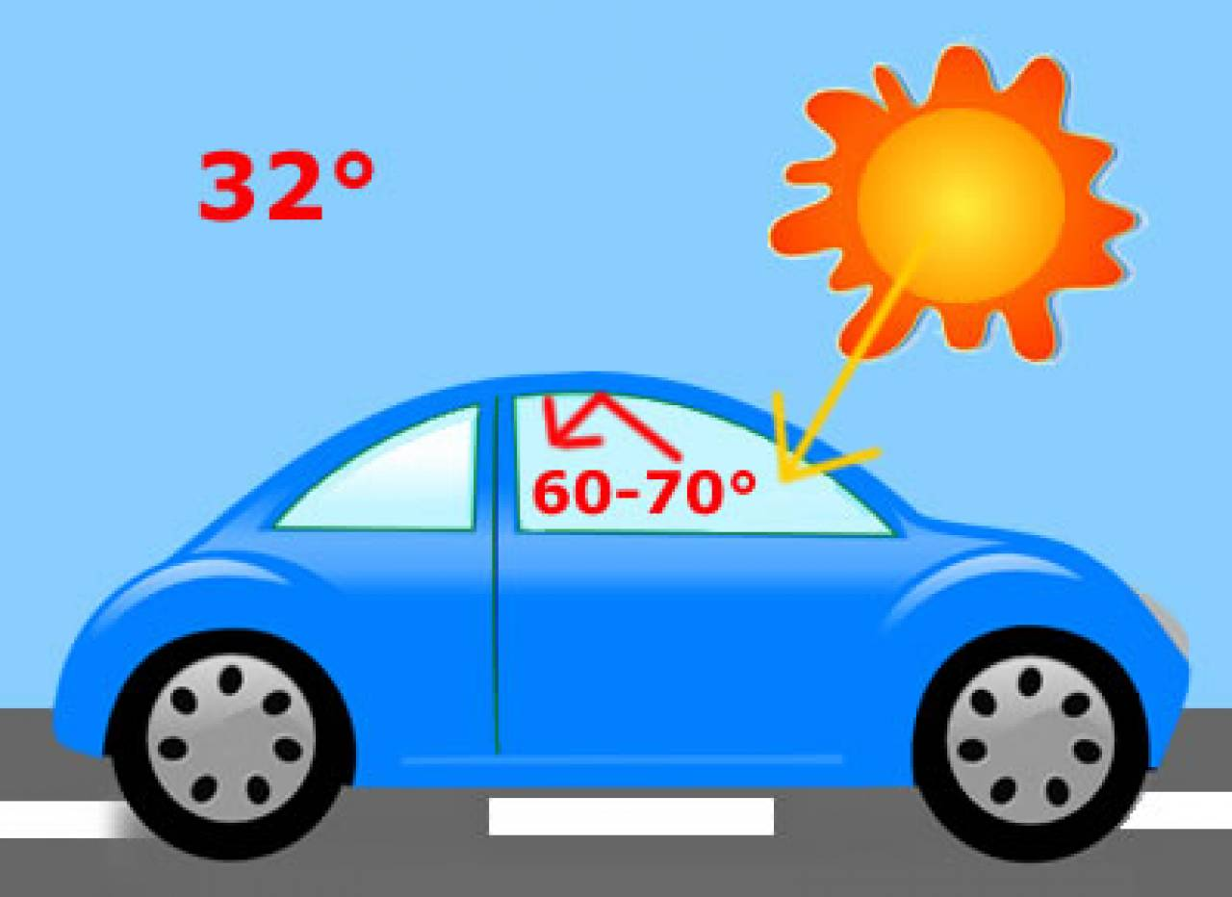
What is Global Warming?
The greenhouse effect is akin to what occurs in a greenhouse or a car under the sun with windows up. The sun's rays warm the air inside, while the glass or greenhouse covering traps the heat, preventing it from escaping, significantly raising the internal temperature.
For Earth, this trapping of heat is performed by 'greenhouse gases.' The most notorious are carbon dioxide (CO2) and methane (CH4), but the most significant is water vapor. Though water vapor is naturally occurring, its increase is driven by the rise in global average temperature.

Slide 9
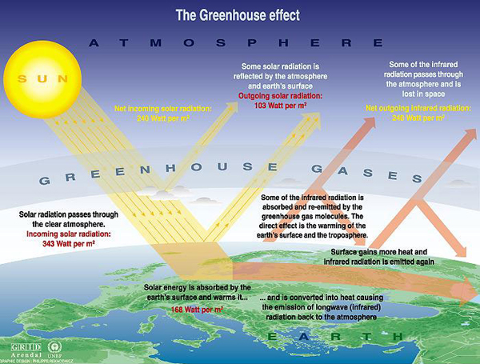

Slide 10
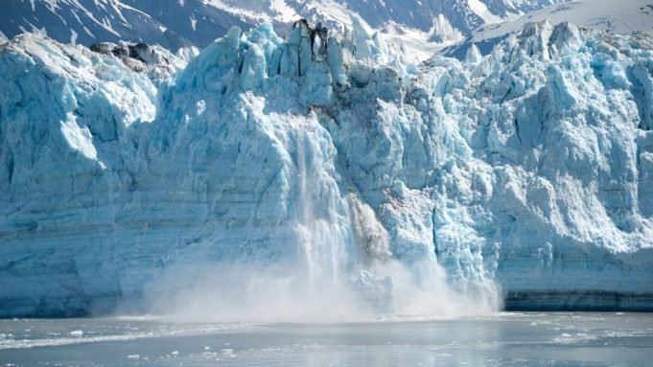
What is Global Warming?
Similar to a greenhouse, the Earth experiences above-normal warming. This rise in global average temperature leads to the melting of glaciers and an increase in sea levels.

Slide 11
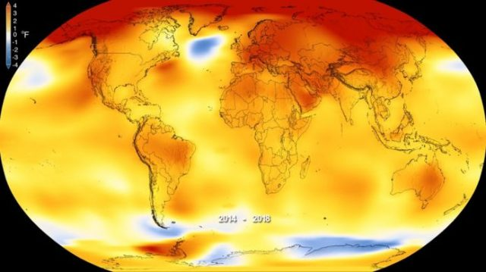
What is Global Warming?
Climate change manifests differently across regions, with local impacts that are challenging to predict. The occurrence of a polar cold spell does not contradict global warming; the underlying cause remains a global imbalance due to global warming. What is certain is the increased frequency and intensity of extreme weather events as the atmosphere warms and gains energy. This is analogous to heating water: initially, small bubbles and gentle motions appear, but eventually, the water boils vigorously, potentially spilling over if the container's rim is not tall enough.
The image on the right illustrates that the Arctic region (North Pole) is warming at a faster rate than the rest of the planet.

Slide 12
The Current Situation: Temperature
The concentration of CO2 in the atmosphere has reached 420 ppm (parts per million), the highest in the last 800,000 years.
The past four years have been the hottest on record since 1880.
Of the 30 hottest years since 1800, 25 have occurred after 1990.
The average global temperature increase has reached 1.2 degrees Celsius. This may seem small, but each additional degree significantly impacts the climate.
2023 could be one of the hottest years ever recorded, potentially exacerbated by the disruption of the "El Niño" phenomenon.
Exceptional temperature records are being set at local levels.
The polar regions are warming much faster than the rest of the planet, leading to dramatic ice melt.
Recently, an area of ice in Antarctica (South Pole) as large as Argentina has disappeared.

Slide 13
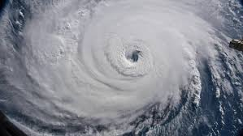
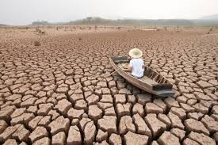
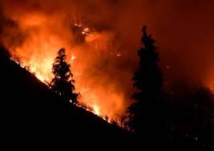
The Current Situation: Extreme Events
Every year, a multitude of exceptional events occurs: hurricanes, fires, floods, and extreme drought. The list is extensive and ever-evolving.
These events are frequently reported by television and newspapers. Often, they are the subject of discussion for a few days, after which there is silence, and little is done to address the underlying causes. In reality, rather than tackling the root causes of these events, efforts are focused on mitigating the symptoms, such as addressing hydrogeological instability.
However, these measures prove inadequate due to the increasing severity and frequency of these extreme phenomena.

Slide 14
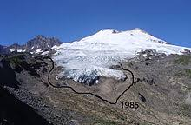
The Current Situation: Ice and Glaciers
The ice of Greenland is melting faster than expected, marking the most significant loss in the last 400 years.
Antarctica lost three trillion tons of ice between 1992 and 2017.
In Ticino, between 1985 and 2009, glacier surfaces reduced by 70%, receding below an altitude of 2,100 meters above sea level.
In the Antarctic region (South Pole), ice melt has reached record levels: an area of ice comparable to the size of Argentina has disappeared.

Slide 15
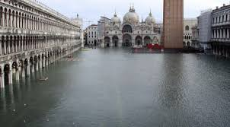
The Current Situation: Sea Level
Over the past 25 years, the average sea level has risen by 7 cm.
Research indicates that the annual increase in sea level is not consistent; it has been increasing by approximately 3 mm per year, with an additional millimeter added each year.
Even a rise of a few tens of centimeters can lead to devastating and irreversible flooding in many populated areas around the world.
In Venice, sea levels are rising at unprecedented rates, and projections suggest that "La Serenissima" might be submerged by the year 2100, according to the "Statistical Report 2018" published by the Veneto Region.

Slide 16
The Current Situation: Warming of the Oceans
The year 2022 set a new record for ocean warming.
Ocean temperatures are rising much faster than previously estimated.
Discussing climate change in terms of air temperature alone is simplistic because the majority of the energy, 93.4%, heats the oceans, as evidenced by the accompanying graph.
Of this energy, 60% is absorbed by the upper 700 meters of the ocean, with the remaining energy heating the deeper layers.
The thermal expansion of the oceans, due to warming, contributes more to sea-level rise than the melting of glaciers.

Slide 17
The Current Situation: Atmospheric Vapor
A significant factor exacerbating the rise in global temperatures is the steady increase in atmospheric water vapor levels.
Over the past 30 years, there has been a consistent rise in humidity within the upper troposphere, ranging from 4.8 to 11.2 kilometers high, which is primarily attributed to human activities.

Slide 18
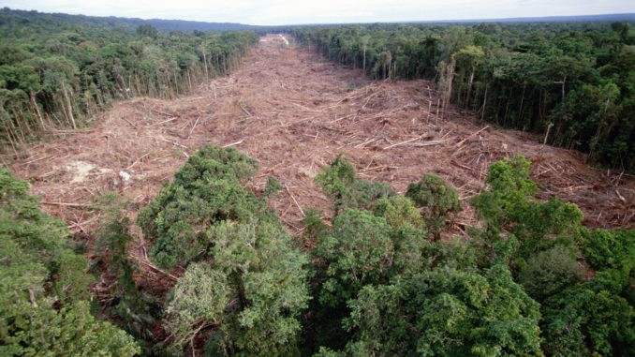
The Current Situation: Deforestation
Forest destruction results in the release of large quantities of CO2, negating their role as carbon sinks.
Regrettably, we lose 13 million hectares of forest annually.
If current rates continue, over 230 million hectares of forest could vanish by 2050.
In 2017, deforestation contributed 7.5 billion tons of carbon dioxide to the atmosphere, which is 50% more than emissions from the U.S. energy sector.

Slide 19
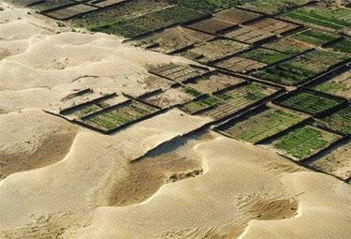
The Current Situation: Desertification
Desertification, similarly to deforestation, diminishes the CO2 absorption capabilities of vegetation.
The reasons for desertification are varied, stemming from natural factors such as increased temperatures, drought, and soil erosion from heavy rains, as well as human-induced factors including unsustainable aquifer usage, removal of fertile soil, and soil compaction due to urban development and certain agricultural practices.
Each year, an area approximately half the size of the European Union, or 4.18 million square kilometers, undergoes degradation. Africa and Asia are particularly hard-hit continents.

Slide 20
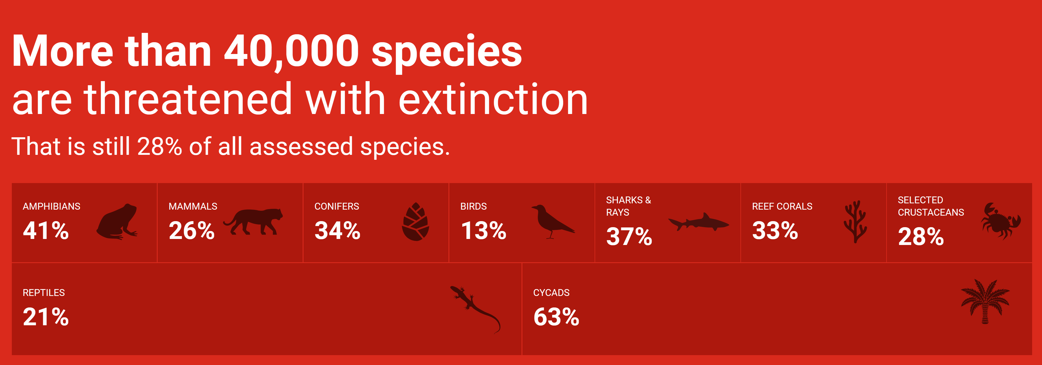
The Current Situation: Extinction of Species
In less than a century, the number of animals on our planet has decreased by 50%.
There are approximately 600 animal species at risk of extinction beyond the over 40,000 species already listed as endangered.
Biodiversity is an invaluable legacy that is vital for the sustenance of life on Earth and must be protected. Consider the role of bees in pollinating and fertilizing fruit trees; their extinction due to global warming would have severe repercussions for agriculture, leading to a scarcity of honey, fruits, vegetables, and livestock feed. This could precipitate widespread famines, threatening our very survival.

Slide 21
The Appeals of Scientists and the Pope
1972 - The Club of Rome publishes "The Limits of Development," asserting that the planet has finite resources and economic development cannot continue indefinitely.
1990 - The first IPCC (Intergovernmental Panel on Climate Change) report is released, followed by subsequent alarming reports every five years.
1992 - The Union of Concerned Scientists issues the world's first "Warning to Humanity," endorsed by over 1,400 scientists, including many Nobel laureates. The document states that human activities are destroying ecosystems, propelling humanity toward an unprecedented global crisis.
2015 - Pope Francis's encyclical "Laudato Si'" advocating for environmental respect is published.
2017 - More than 15,000 scientists from 184 countries issue a second warning, claiming "we are close to doing irreversible damage to Planet Earth."
2023 - Pope Francis publishes the apostolic exhortation "Laudate Deum" addressing climate change.
Unfortunately, these appeals have largely gone unheard or have been underestimated by politicians.

Slide 22
What are Governments doing
1992 - The Treaty of Rio did not establish mandatory limits for greenhouse gas emissions for individual nations, but it did require signatories to convene in special annual conferences (Conference of the Parties, COP) to sign agreements aimed at reducing CO2 emissions.
1997 - The Kyoto Protocol's declared objective was "to achieve the stabilization of greenhouse gas concentrations in the atmosphere at a level that would prevent dangerous anthropogenic interference with the climate system."
2015 - At the Paris Climate Conference, states set the ambitious target of limiting the global temperature increase to within 1.5 degrees Celsius.
Since then, the COP conferences have been held almost every year. COP27 took place in Sharm el-Sheikh in 2022, but only limited progress has been made. Numerous declarations of intent were not honored, and many commitments were made but were not legally binding.

Slide 23
What Governments Are NOT Doing
Eight years after the signing of the Paris Agreement, the situation is far from optimistic.
The core issue is that the commitments made are voluntary; there is no binding obligation. Thus, the Paris Agreement often stands as a testament to good intentions rather than enforceable action.
Only 16 out of the 197 countries that signed the Paris Agreement have formulated a national climate action plan robust enough to fulfill their commitments.
The coal industry wields considerable influence on a global scale, and the aim of gradually decarbonizing the economy is hindered by the substantial investments required.
Politicians, regrettably, tend to focus on securing as many votes as possible in upcoming elections, overlooking long-term consequences. The predominant discourse revolves around GDP and growth, which are expected to rise annually, ignoring the fact that perpetual growth is unsustainable due to finite resources and is akin to the nature of tumors.
“We cannot solve our problems with the same thinking we used when we created them.” - Albert Einstein

Slide 24
Why Is It Progressing Faster Than Anticipated?
There are many indications that, unfortunately, global warming is progressing much faster than expected and will be much more severe than you think.
This is particularly due to:
The inadequacy and inefficiency of policies that fail to address long-term issues.
The individual selfishness and resistance to change by the vast majority of people.
National interests taking precedence over global concerns.
Positive feedback loops that exacerbate the amount of greenhouse gases emitted into the atmosphere.

Slide 25
Why Is It Progressing Faster Than Anticipated?
Scientists have set 2030 as the deadline by which it would still be possible to limit the increase in global average temperature to 1.5 degrees Celsius above pre-industrial levels. If this threshold is exceeded, positive feedback loops will make it impossible to halt the heating process, even if we were to magically eliminate all emissions. Unfortunately, these feedbacks are accelerating the phenomenon.
Let’s examine in detail what this entails:
Melting of ice and ice caps
Thawing of the permafrost
Ocean heating, acidification, and desalination
Release of methane hydrates from the ocean floor
Increase of water vapor in the atmosphere
Widespread fires
Thickening of the leaves

Slide 26
Why Is It Progressing Faster Than Anticipated?
Melting of ice
and polar ice caps
The melting of ice, including polar ice caps, has significant implications for global temperatures. Snow and ice reflect a high amount of sunlight, whereas the darker soil absorbs more heat. When the ice completely melts and leaves the ground exposed, the soil temperature increases significantly. This, in turn, accelerates the melting of the remaining ice, creating a feedback loop that contributes to an overall rise in global temperatures.

Slide 27
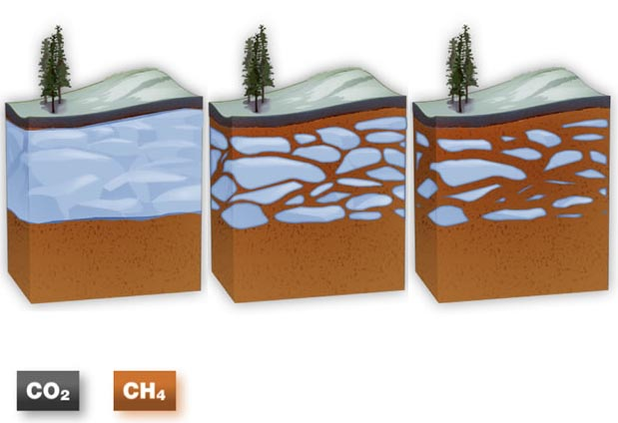
Why Is It Progressing Faster Than Anticipated?
Melting of the Permafrost
Permafrost refers to ground that remains frozen year-round, extending deep below the surface. Spanning approximately 19 million square kilometers, it covers about 24 percent of the Earth's northern hemisphere. This frozen soil is rich in methane, a potent greenhouse gas which is estimated to have 20 to 30 times the impact on global warming compared to carbon dioxide. As temperatures rise, permafrost thaws, leading to the decomposition of organic material. This process releases methane (CH₄) and carbon dioxide (CO₂) into the atmosphere, further exacerbating the warming effect.

Slide 28
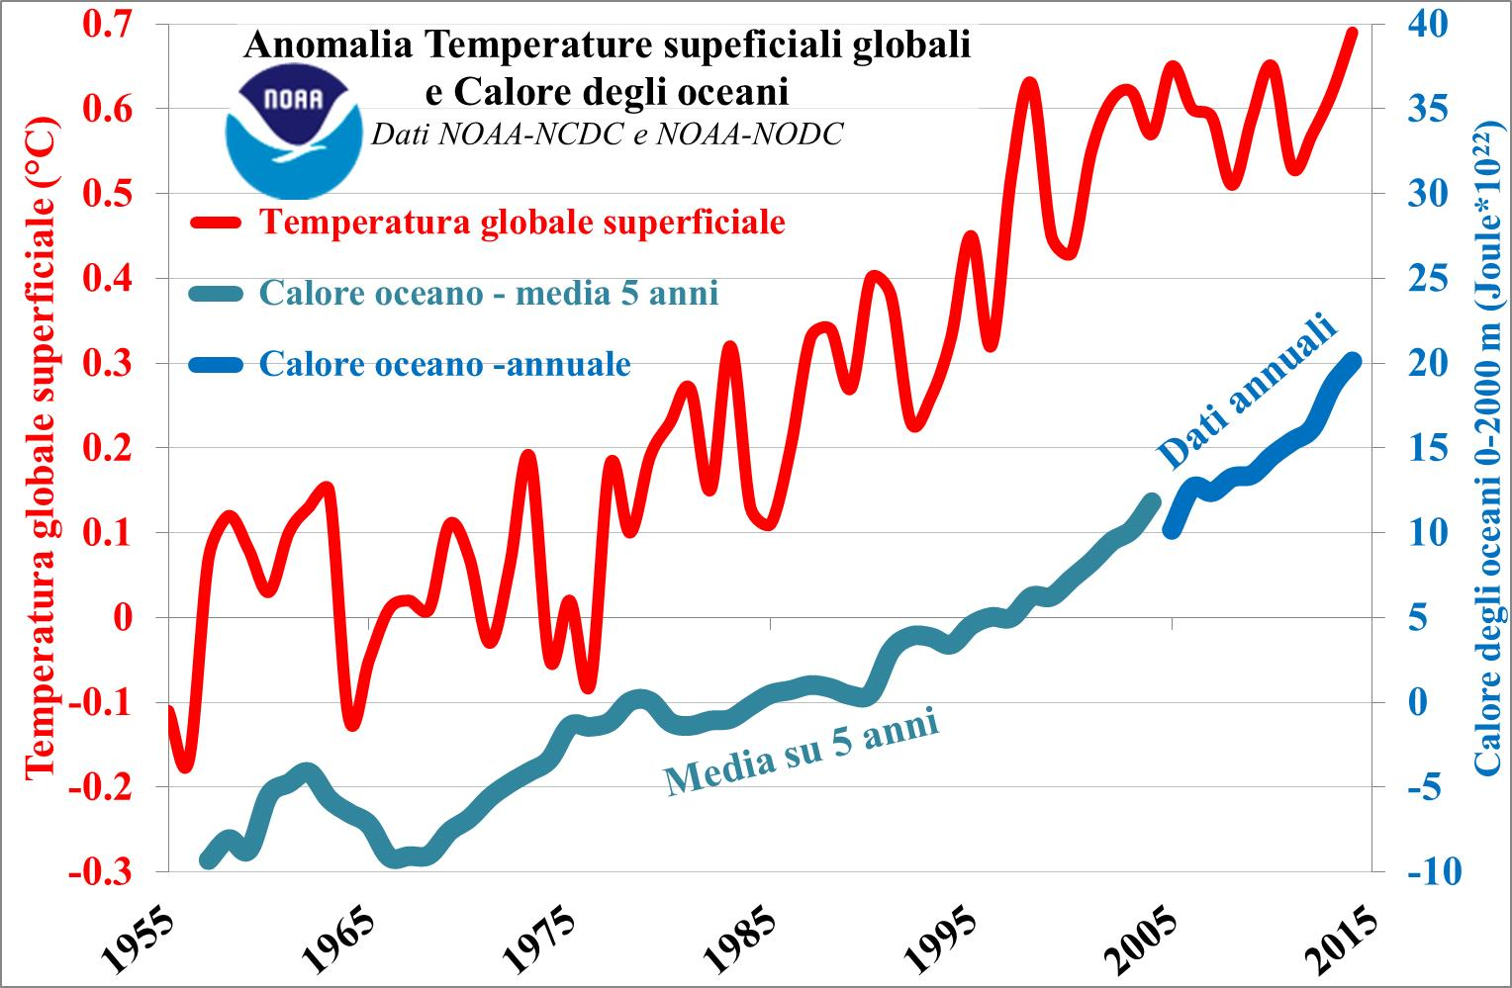
Why Is It Progressing Faster Than Anticipated?
Warming of the oceans
The oceans act as a major heat sink, absorbing about 90% of the excess heat generated by global warming, which leads to an increase in their temperatures. As water warms, its ability to dissolve CO2 diminishes, resulting in more CO2 being released back into the atmosphere. This release further amplifies global CO2 levels, creating a feedback loop that intensifies the effects of global warming.

Slide 29
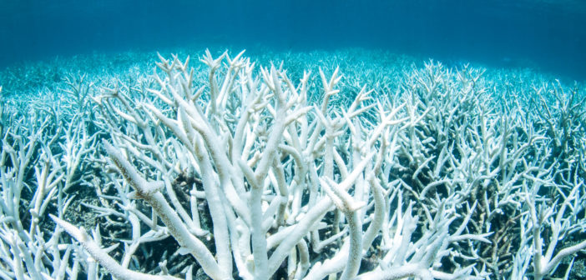
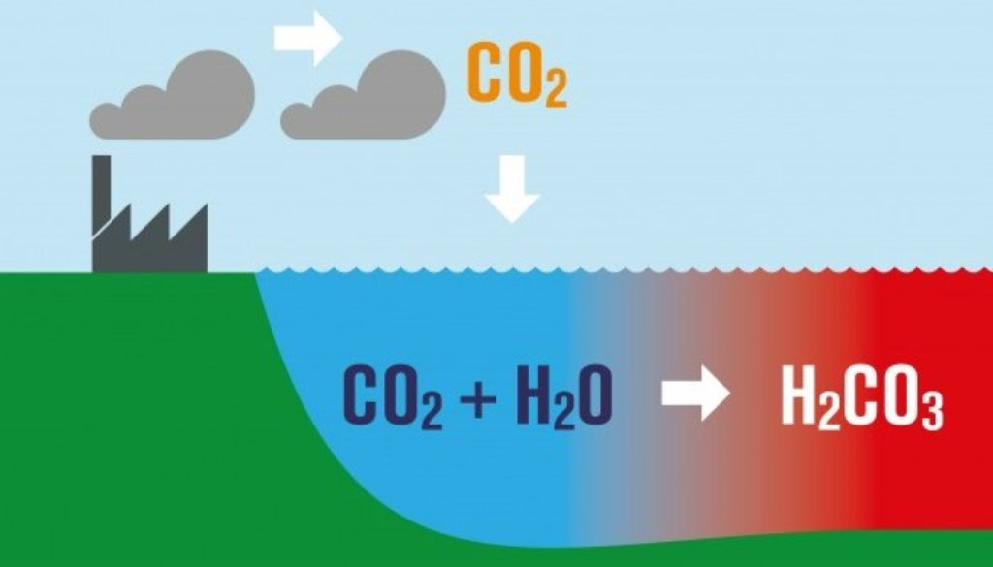
Why Is It Progressing Faster Than Anticipated?
Acidification of the oceans
Rising levels of atmospheric carbon dioxide not only contribute to global temperature increases but also disrupt marine ecosystems. This disruption includes coral bleaching, which can lead to coral mortality. The oceans absorb about a quarter of all CO2 released into the atmosphere annually, which, when dissolved in seawater, forms carbonic acid. Since 1800, the acidity of the oceans has risen by 30%, negatively impacting their capacity to sequester CO2.

Slide 30
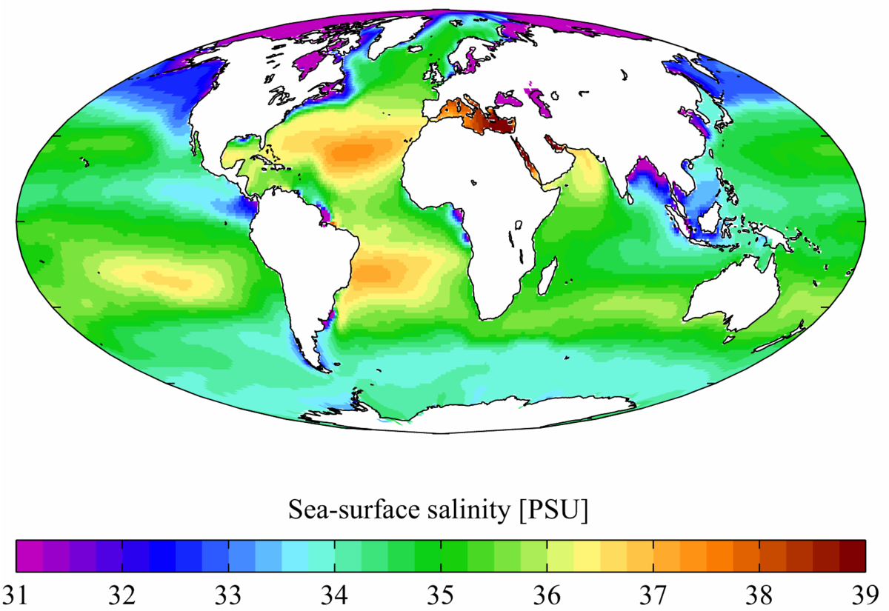
Why Is It Progressing Faster Than Anticipated?
Desalination of the oceans
The reduction in salinity, due to the intake of fresh water from melting ice, is decreasing the CO2 absorption capacity of the oceans. The Antarctic Sea absorbs as much as 40% of the carbon dioxide produced by human activities.
This disruption threatens to compromise a delicate balance and greatly fuel the feedback mechanism.

Slide 31
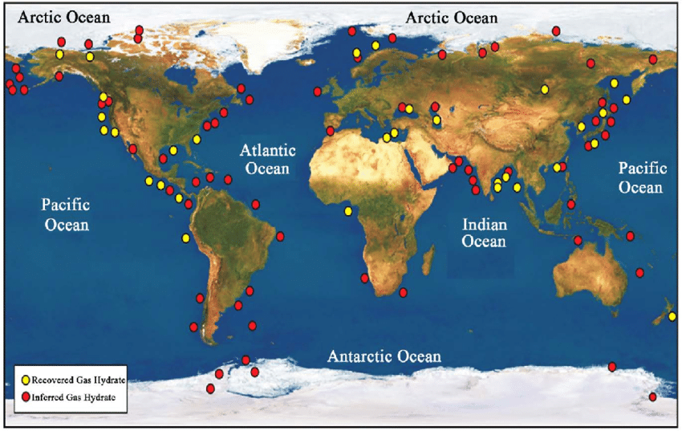
Why Is It Progressing Faster Than Anticipated?
Melting of methane hydrates in the ocean floor
One of the largest methane reservoirs on the planet is methane hydrates. They are cage compounds, that is, lattices of molecules of frozen water that incorporate methane inside them, which are created under conditions of high pressures and low temperatures. They are usually located at the bottom of the sea where the water is very cold and the pressure, due to the depth, very high.

Slide 32
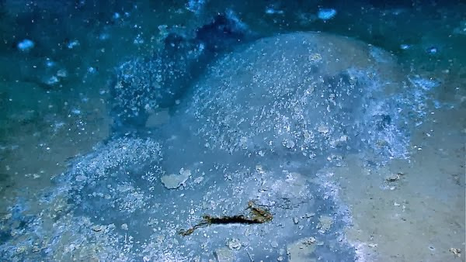
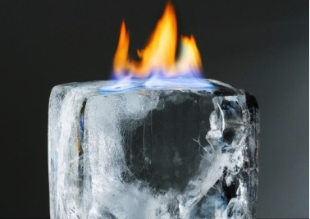
Why Is It Progressing Faster Than Anticipated?
Melting of methane hydrates in the ocean floor
As the temperature rises, ice can melt and thereby release methane that would rise to the surface and then enter the atmosphere. Let's remember that methane is a greenhouse gas more than twenty times more potent than carbon dioxide. The release of methane from hydrates can thus lead to a dangerous rise in the greenhouse effect. This would cause further increases in temperature and thus the potential release of other hydrates, with the release of more methane, and so on.

Slide 33
Why Is It Progressing Faster Than Anticipated?
Melting of methane hydrates in the ocean floor
In October 2020, scientists from an international team aboard the Russian research vessel R/V Akademik Keldysh found evidence that frozen methane deposits in the Arctic Ocean have begun to release.
It must be emphasized again that methane is a potent greenhouse gas, with an effect on atmospheric warming that is 20 to 30 times greater than that of CO2!
In this case, too, as the temperature of the oceans increases, hydrates will melt more rapidly, releasing ever-greater quantities of methane that will fuel the vicious cycle and lead to an increase in the global average temperature.

Slide 34
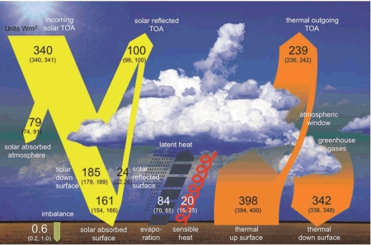
Why Is It Progressing Faster Than Anticipated?
Increase in water vapor in the atmosphere
Greenhouse gases are known to be responsible for global warming by trapping Earth's thermal radiation.
This mechanism also increases the accumulation of atmospheric water vapor, which is considered the quintessential greenhouse gas. In turn, more vapor leads to higher humidity, which causes even more heat, triggering a vicious cycle in the warming process.

Slide 35
Why Is It Progressing Faster Than Anticipated?
Extensive fires
The conditions that cause wildfires are exacerbated by scorching heat and the resultant drought due to global warming, which, in turn, is exacerbated by the fires. Indeed, the vast and numerous wildfires that have struck various parts of the planet in recent years (California, Amazon, Siberia, Indonesia, Greece, Italy, Spain, etc.) have not only released a huge amount of CO2 into the atmosphere but have also removed a substantial portion of the forests' capacity to absorb it, which will be impossible to replace quickly. This has led to a further increase in this greenhouse gas, thereby contributing to an acceleration of the rise in global temperature and, consequently, to the number and severity of fires, in a cycle that repeats itself every year.

Slide 36
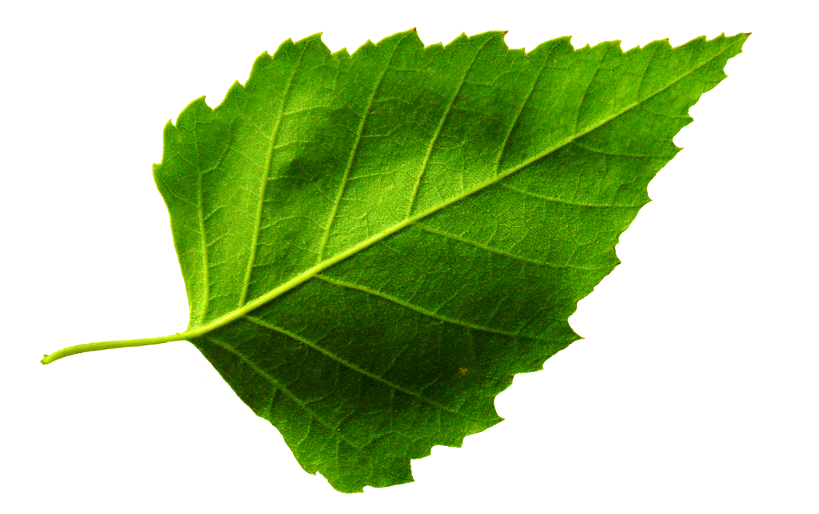
Why Is It Progressing Faster Than Anticipated?
Leaf thickening
Following the increase of carbon dioxide in the atmosphere, plants have a curious reaction: they increase the thickness of their leaves by up to a third, partially altering their ability to capture CO2 and thus sequestering less atmospheric carbon.

Slide 37
Consequences of Global Climate Change
The consequences of climate change are numerous and become more severe as the global average temperature rises:
Heavy rainfall
Hurricanes
Floodings
Landslides and mudslides
Extreme drought
Desertification
Famines
Fires
Melting of ice
Sea level rise
Species extinction
Migrations of entire populations
Wars over water and arable land
These natural disasters do not strike in a uniform way. One continent may experience extreme drought, while another may have intense rainfall, floods, or hurricanes.

Slide 38
What Must Be Done to Mitigate Its Effects
First of all, it must be stressed that effective action must be taken at global level, not only by effective and immediate policy measures, but also by changing the way citizens live.
There are many things to do to combat the Greenhouse Effect that can implement the policy, for example:
Reduce consumption
Transform intensive farming into extensive farming
Plant a trillion trees
Introduce environmental crime
Encourage non-polluting transport systems
Make public transport free and develop it
Redistribute wealth
Purchase local products + sustainable agriculture
Increase energy efficiency in all fields
Implement a Carbon Tax
Provide incentives for renewables
Remove incentives for fossil fuels
Recover and recycle as much as possible
Reduce urban sprawl
Implement a birth control policy
Convert armies into civil engineering corps
Limit flight hours for leisure
Implement a fuel pricing policy
Regulate cryptocurrencies

Slide 39
What Must Be Done to Mitigate Its Effects
Reduce consumption
We must not delude ourselves into thinking that simply turning to renewable energy sources or electric cars is enough. We also need to consume less. For fifty years it has been made clear to us that infinite growth is not possible because resources are finite and pollution is suffocating us. Yet politicians relentlessly continue to talk about growth. While economic growth does bring prosperity in certain respects, it does not automatically bring happiness and health, and above all, it is consuming the future of the next generations.
The only thing that saves 100% on pollution is non-consumption. Anything else always has an impact on the environment, either due to its manufacturing or because the energy used does not come entirely from renewable sources.
It is pointless to increase the production of renewable energy if the increase is then used for greater consumption or to meet the higher demand due to population growth.

Slide 40
What Must Be Done to Mitigate Its Effects
Transforming Intensive Farming
The first thing that can be done to reduce the impact of global warming at no cost, with very decisive and almost immediate effects, and with positive repercussions for human health and the environment, is something that is little talked about: transforming intensive farms into extensive ones and drastically reducing the consumption of red meat, adhering to the "true" Mediterranean Diet, the one of our grandparents for understanding.
Intensive farming indeed contributes to the greenhouse effect by as much as 14.5%, which is more than all transport by land, sea, and air combined!
How is this possible? A percentage of the so-called "greenhouse gases," like CO2 (carbon dioxide), is due to the respiration of animals; methane, however, which contributes to the greenhouse effect more than 20 times that of CO2, is produced by the digestive processes of the rumen of cattle, sheep, and goats and from the evaporation of gases contained in manure which, instead of being used in place of chemical fertilizers, is left unused to evaporate into the atmosphere.
On Earth, an enormous number of animals estimated at around 24 billion are raised to provide the meat we consume every day.
Farms are also responsible for the high presence of CO2 in the atmosphere, also due to the destruction of thousands of hectares of forests to make way for pastures.

Slide 41
What Must Be Done to Mitigate Its Effects
Planting a Trillion Trees
Another immediate action that would also lead to an increase in job opportunities is to plant billions of trees worldwide, both by reforesting and by planting in all abandoned areas, whether urban or rural, with broadleaf or fast-growing species like poplars, which absorb a lot of CO2 in a relatively short time.
Planting trees to obtain credits, as gas and oil multinationals are doing in order to continue polluting, is not the right approach. The entire carbon credit system, which should be immediately abolished because it only serves to "greenwash," that is, to seemingly solve the problem while actual decisive action is indispensable.
In every city and municipality, there are uncultivated lands or areas left green where grass often grows untended due to lack of funds. Planting trees and shrubs in all these areas would not only absorb many pollutants, mitigate the climate, provide more oxygen, make the areas more attractive and pleasant, but above all, it would contribute significantly to the reduction of Global Warming.

Slide 42
What Must Be Done to Mitigate Its Effects
Introduction of the Environmental Crime
But planting many trees is not enough because it takes many years for new plants to absorb significant amounts of CO2, while when a tree is cut down or burned, it immediately stops absorbing it.
Therefore, it is also necessary to protect existing woods and forests and to invest heavily in all means of fire prevention and control.
Consequently, environmental crime must be introduced worldwide with very severe penalties, particularly for arson that, in addition to directly emitting large quantities of carbon dioxide, destroys trees, thus nullifying their absorption capacity. Moreover, a global law should be enacted that prohibits construction or use for other purposes on areas affected by fire for many years.

Slide 43
What Must Be Done to Mitigate Its Effects
Encouraging Non-Polluting Transport Systems
Our legs are the most sustainable means of transport in the world, and moving has very positive effects on our health. Therefore, incentives for using bikes and walking could be implemented through dedicated apps (some of which already exist) that give credits for each kilometer traveled. In large cities, bike sharing is a good solution. To encourage biking and walking, however, more investment is needed in bike and pedestrian paths.
Electric vehicles should be highly encouraged but only if they can be charged 100% by renewable sources since we know well that the electricity available on the grid is only about 30% from renewable sources. A good idea would be to install photovoltaic canopies in the parking lots of companies and shopping centers to charge cars during parking and to keep them shaded in the summer.
Other good practices to spread and incentivize are carpooling and car sharing.
Trains are also the best solution for freight transport, but investment is necessary in infrastructure for intermodal transport (truck + train).

Slide 44
What Must Be Done to Mitigate Its Effects
Making Public Transportation Free and Developing It Worldwide
Making public transportation free worldwide would be a drastic but very effective solution. To save money, all citizens would be encouraged to leave their private vehicles at home and use public transportation for free.
The costs that would have to be borne by nations and local communities could be covered by funds from climate taxation (carbon tax) and from strongly progressive taxation on great wealth.

Slide 45
What Must Be Done to Mitigate Its Effects
Redistribution of Wealth
There is also a need to reverse the long-standing trend where the rich get richer and the poor get poorer, with a very progressive taxation to begin rebalancing and narrowing the gaps.
It is also time for the world to abolish tax havens, drastically reduce tax evasion with monitoring of bank accounts as well as assets owned by every citizen, impose increasingly tighter limits on cash, and apply heavy taxation on speculation and excess profits so that everyone contributes as much as possible to financing the ecological transition.
The proceeds should also be used to help the poorest nations and support them in their commitment to not increase their emissions.

Slide 46
What Must Be Done to Mitigate Its Effects
Buying Local Products
When it comes to the issue of climate change, the inevitable response is: "But what can I do?"
One thing we ALL can do is decide what to consume. If, for example, we all stopped buying fruit and vegetables that come from the other side of the world and settled for zero-kilometer and seasonal produce, there would be enormous savings in emissions and pollution, as well as being great for health, quality, and taste of products.
Even mineral water, which heavily impacts pollution in transport from far-away bottling locations, should be chosen taking into account the distance from the source, or better yet, use purified and improved tap water which we can draw from the so-called "public fountains" that many municipalities have already made available to citizens. This system should be extended everywhere, funded by carbon tax contributions.

Slide 47
What Must Be Done to Mitigate Its Effects
Sustainable Agriculture
Deep plowing (over 45 cm) is very harmful as it destroys the fertility of the soil, not to mention the huge costs involved. The clods produced by deep plowing will need to be broken down with various passes, which requires a lot of diesel and significant emissions into the atmosphere as well as destroying insects, millipedes, and especially earthworms that incorporate humus into the soil, which has formed or been applied to the surface, thus increasing the fertility of the soil. With this type of cultivation, organic matter vanishes year after year. It would be possible to reduce the impact of agriculture on the climate by 30% by switching to innovative technologies and conscious practices.

Slide 48
What Must Be Done to Mitigate Its Effects
Increasing Energy Efficiency in All Areas
The energy efficiency of many things can be improved: from better thermal insulation of our homes and public buildings to the efficiency of appliances and transportation means, to company machinery, home systems, and much more. Some progress is being made in certain areas, but much more investment is needed. Investments in energy efficiency pay for themselves with the resulting energy savings and, in addition, create new jobs.
Implementing the Carbon Tax
The Carbon Tax is a tax on energy products and services that cause carbon dioxide emissions into the atmosphere. It was introduced in Italy at the end of the '90s but unfortunately has never really been implemented. The purpose is to reduce greenhouse gas emissions and to encourage states and end consumers to prefer more ecological and thus less polluting solutions. The amount of the tax to be paid increases with the pollution produced. It is the measure that would most directly and promptly reduce CO2 emissions.

Slide 49
What Must Be Done to Mitigate Its Effects
Provide Incentives for Renewables and Remove Them for Fossils
It is necessary to remove any incentive for fossil fuels and incinerators, and instead, increasingly incentivize all renewable energy sources:
Photovoltaic
Concentrated Solar Power
Wind
Biogas
which we will examine individually below.
It would also be helpful to simplify the environmental assessments required
by national regulations.

Slide 50
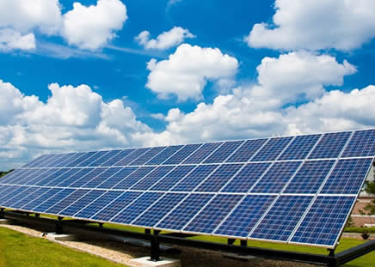
What Must Be Done to Mitigate Its Effects
Photovoltaic
In addition to heavily investing in the research for ever-improving and high-performance materials and funding the increasingly widespread diffusion of photovoltaic systems, including the establishment of cooperatives for local energy production up to 20 kWp, another excellent idea, as already mentioned, is to subsidize modular photovoltaic canopies at all workplaces, designed based on the number of employees who use an electric car.
The employee, who often lives far from the workplace, parks the car during the day (moreover, in the shade during summer) under a photovoltaic canopy with a charging socket. When they leave, the car is already fully charged with energy and therefore can travel practically for free and without emissions!
All public parking lots and those of shopping centers should also be equipped with photovoltaic canopies that, in addition, provide protection from the sun.

Slide 51
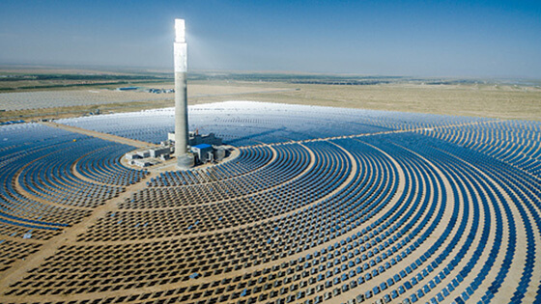
What Must Be Done to Mitigate Its Effects
Concentrated Solar Power (CSP)
Concentrated Solar Power is a simple and ancient solution for producing heat. A parabolic mirror concentrates the sun's rays at a single point called the "focus," generating a temperature of about 550 °C. At the same point, a tube passes through which a fluid capable of storing heat flows, and thanks to a heat exchanger, it is then used to generate steam to spin a turbine and produce electricity.
The molten salt technology was conceived by Nobel laureate Carlo Rubbia and developed by ENEA. A fundamental aspect is the ability to store energy in the form of high-temperature heat. This way, it is possible to overcome the disadvantage of solar energy related to the day/night cycle and atmospheric conditions. Despite the molten salt technology being invented and developed in Italy, it has unfortunately been set aside in our country due to bureaucracy, local protests, and lack of incentives. It is, however, gaining ground in other more far-sighted and enterprising countries, particularly in China. Bureaucratic hurdles must be overcome, and the technology must be spread worldwide.

Slide 52
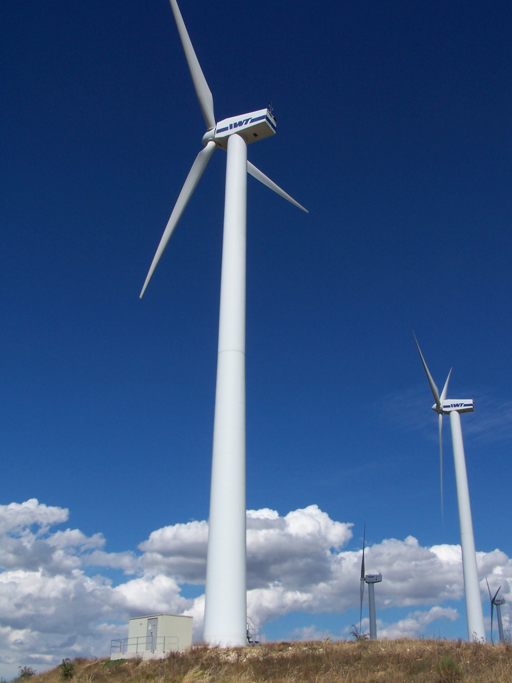
What Must Be Done to Mitigate Its Effects
Wind Energy
In addition to increasing the existing parks, given the bureaucratic difficulties that must nonetheless be eliminated, and environmentalist resistances that should be accommodated when possible but overcome, urgent action is needed with the so-called "Repowering and Revamping" to quickly increase the amount of energy produced by current wind installations. Repowering is the process of completely replacing the wind generator with a new, more powerful, and efficient one to increase the yield of the plant. Due to the intrinsic degradation of modules and turbines, the current installed generation capacity reduces over time, unless it is replaced with new components. Consequently, the adoption of normative instruments aimed at incentivizing Repowering interventions becomes necessary to increase the current levels of low-carbon generation capacity.
With the Revamping intervention, only obsolete or worn components are replaced, always with the aim of improving the performance of the entire plant. The main improvements that can be achieved with Revamping are attributable to Reblading, that is, the mere replacement of turbine blades with more efficient ones and the replacement or updating of control software to adapt it to the specificities of the new blade adopted.

Slide 53
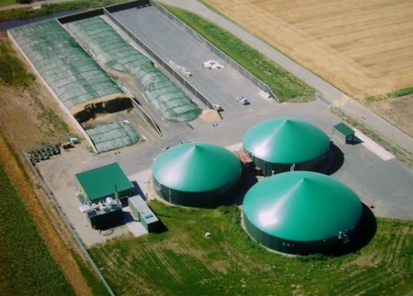
What Must Be Done to Mitigate Its Effects
Biogas
An alternative source of energy that is not fully exploited is biogas, which uses plant waste and excretions. It should be valued and encouraged.
Biogas is the result of the fermentation, in the absence of oxygen and at a controlled temperature, of organic substances coming from agricultural residues, zootechnical or sewage effluents, integration crops, the organic fraction of selectively collected urban waste, etc., by numerous bacteria. The result of the process is biogas, which has a high calorific value and can be converted into electricity and heat thanks to a co-generator. The fermentation residue is used as a natural fertilizer in crops.
Biogas is one of the resources that, if systematically implemented wherever possible, could validly contribute to energy autonomy and the reduction of the greenhouse effect, being a clean and flexible energy source that generates both electrical energy and heat, and also enhances waste and by-products.
The new generation of biogas production plants are capable of generating advanced biomethane, a gas equivalent to methane of fossil origin but of biological origin.

Slide 54
What Must Be Done to Mitigate Its Effects
Recover and recycle as much as possible worldwide
The strict rule of the 4 "R's" must be applied: Reduce, Reuse, Recycle, Recover.
Reduce or eliminate packaging as much as possible and make it all highly recyclable.
Reuse everything that can be reused, and when it can no longer be used, it should go to the landfill.
Recycle all recyclables in an optimized way by clearly and legibly indicating on the products the type of recycling that the item is subject to. The best method for collection is differentiated door-to-door pickup that should be carried out everywhere.
Recover from objects that go to landfills everything that is recoverable, even if it is not very economically advantageous.
Finally, planned obsolescence must be definitively eliminated to be able to exploit objects for as long as possible.

Slide 55
What Must Be Done to Mitigate Its Effects
Reduce Cementification
The global cement industry pollutes more than entire nations like China and the United States.
With the expansion of urban areas in many countries, especially in Asia, cement production could increase by 25% by 2030. That's why the construction sector should seek to use new, more "sustainable" materials.
Cement is one of the sectors considered most difficult to decarbonize: to limit its environmental impact, it will necessarily focus on methods of circular economy, which include, for example, the recycling and reuse of materials and the design of lighter, more durable, and efficient buildings thanks to bio-building techniques.
In any case, the best way to emit less CO2 into the atmosphere due to cement is to cement and build less, in addition to recovering the existing building heritage.

Slide 56
What Must Be Done to Mitigate Its Effects
Implement a Birth Control Policy
The world population is increasing uncontrollably. While it is true that too few children are born in some nations, like in Italy, and the population is aging, in many other parts of the world, especially in poorer countries, too many children are being brought into the world. It is predicted that by 2050 the world population will approach 10 billion individuals.
It is true that in places where many children are born, such as Africa, which is home to more than half of the world's poorest people, only a minimal part of historical emissions is responsible. However, even the poorest rightly aspire to improve their living conditions, and if we do not put a brake on this growth, not only will we further deplete the few resources and pollute the planet more, but there will also be fewer resources for them and many more problems.
A proper birth control policy with incentives and support for those who limit births, free provision of contraception and counseling, sexual education in schools, and more, is absolutely essential to combat Global Warming.

Slide 57
What Must Be Done to Mitigate Its Effects
Reconvert armies into civil engineering
A scandalous issue that no one protests is the military spending that has reached two billion Euros per year at the global level and is continuously growing. We already have enough weapons to completely destroy our planet several times over. Yet submarines, aircraft, and missiles are continuously studied and produced, becoming more and more performant and increasingly devastating. The United States is even investing in defense and space warfare.
Then there's the pollution from the world's armies. It has been estimated that they emit 5% of global greenhouse gas emissions. More than all of civil aviation.
We must realize that the current enemy of all is global warming and use those resources, means, and men to fight it by achieving global peace and reconverting armies into civil engineering to carry out works of resilience and containment of the negative effects of climate change.

Slide 58
What Must Be Done to Mitigate Its Effects
Limiting recreational flight hours
The impact of emissions from air transport is very high when calculated on a per-passenger per-kilometer basis.
Traveling is wonderful, but given the current situation, we can no longer afford to pollute carelessly.
We must therefore make a relative sacrifice by limiting the number of flight hours for vacations available to each person instead of just acting on price, because by doing so we would disadvantage the less wealthy who, instead, have the same right to travel.
Obviously, business trips would be excluded from these limitations.

Slide 59
What Must Be Done to Mitigate Its Effects
Implement a fuel pricing policy
The consumption of fuels for non-strictly necessary uses should be penalized by increasing the price with a Carbon Tax while completely relieving carriers through refunds or deductions to avoid unnecessary spikes in inflation.
Workers would receive a monthly reimbursement for the necessary kilometers to commute to work. For everyone, a one-time annual relief for strictly necessary personal uses.

Slide 60
What Must Be Done to Mitigate Its Effects
Regulate Cryptocurrencies
A little-known fact is that cryptocurrencies produce significant emissions. To produce Bitcoin, for example, the energy consumed by an entire state is currently absorbed, and as new ones are produced, the energy required to produce them increases.
Moreover, these virtual currencies are used for untraceable payments that facilitate illegality and tax evasion. It is necessary to halt new production and make the existing ones traceable.

Slide 61
What to do all of us as individuals
Some things we need to do right away:
Consume less red meat. As we have seen, intensive livestock farming is one of the main causes of Global Warming. Moreover, reducing meat consumption, especially red meat, is also good for health. It is scientifically proven that the true Mediterranean diet (very little red meat and lots of fruit, vegetables, legumes, pasta) keeps diseases away and extends life.
Replant trees. If you have a garden, a vegetable garden, or a piece of land, plant trees, hedges, or shrubs on it. Pressure your municipality to plant many more trees in grassy or fallow areas. Trees absorb a lot of CO2, especially the larger ones.
Install solar panels. If you have a few thousand Euros to invest, installing photovoltaic or thermal panels on your roof will yield much more than keeping the money in the bank. Also, with photovoltaics, if there are multiple energy-hungry appliances in use, the limiter will not trip if the sun is shining.
Walk and cycle more. It’s good for your health, your wallet, and the environment.
Fly less and take the train more often. Use the car only if it’s indispensable.
Recover and recycle as much as possible. Follow the "4 Rs" rule: reduce, recycle, reuse, repair. If you have items you no longer use, instead of throwing them away, resell them online or at markets.

Slide 62
What to do all of us as individuals
We must put pressure on politicians to act on what has been said before while there is still time, but this is not enough: each one of us must also commit to adopting behaviors that preserve the environment.
We owe it especially to our children or grandchildren and to future generations. We cannot leave them an uninhabitable Earth.
The revolution can only come from the bottom. If we wait for politicians to act on their own initiative, we will die hoping.
Let's fight together for our future and for that of the next generations. You too can join the pacifist and environmentalist movement "No-Extinction".
www.no-extinction.org

